Slide 1
Sequence to Sequence Modeling

Slide 2
Outline
Machine Translation
Encoder
Decoder

Slide 3
Machine Translation
“Lets go”
“Tara”
“I am Elizer”
“Ako si Elizer”

Slide 4
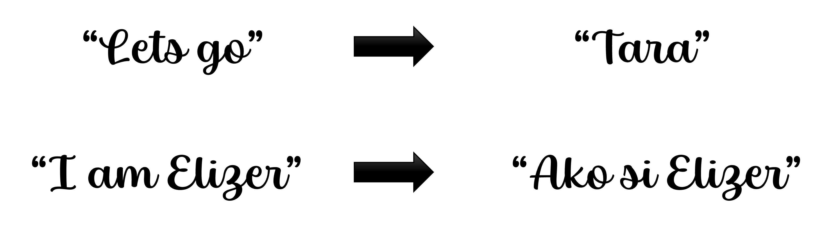
In machine translation, we have a sequence of words for English that needs to be translated into sequences of words to Tagalog.

Slide 5
This task and many others are called sequence-to-sequence or seq2seq problems

Slide 6
One way to solve seq2seq problems is with something called an Encoder-Decoder model

Slide 7
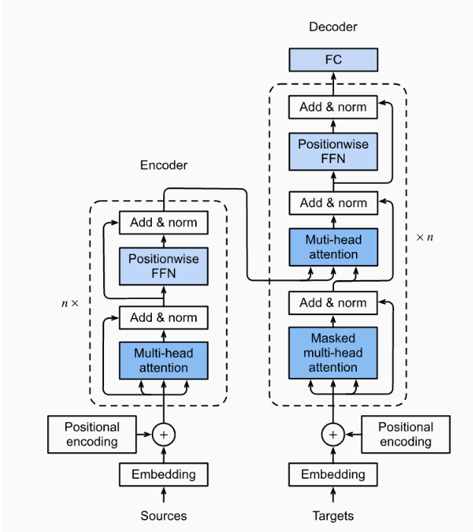
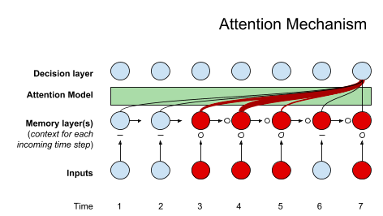
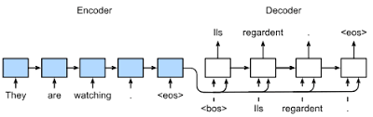
Seq2Seq
Attention
Transformers
Seq2Seq models will be a step towards understanding Transformers, which forms the basis of Large Language Models like OpenAI’s GPT models.

Slide 8
Going back to machine translation, the first problem that we have to deal with is that not all sentences in English are the same length

Slide 9
Likewise, not all Tagalog sentences are the same length so we need something that can generate different length sentences as output

Slide 10
Lastly, the Tagalog translation of an English sentence can have different length than the original

Slide 11
Lastly, the Tagalog translation of an English sentence can have different length than the original

Slide 12
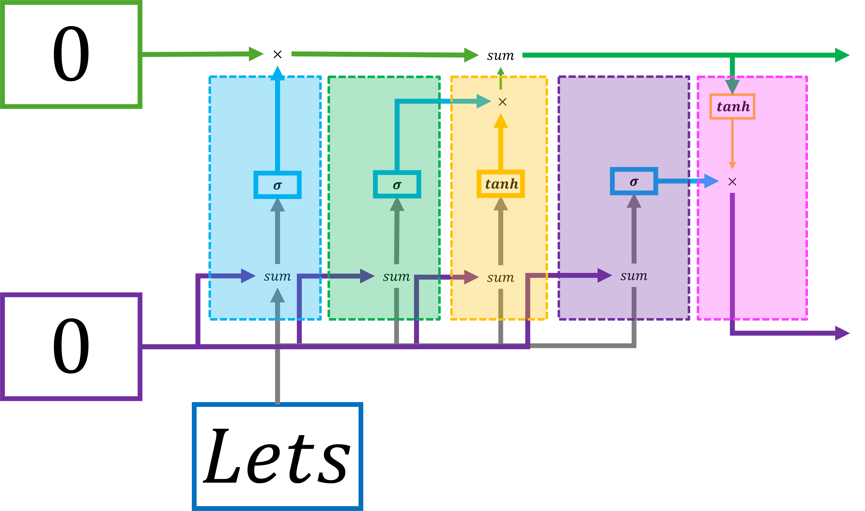
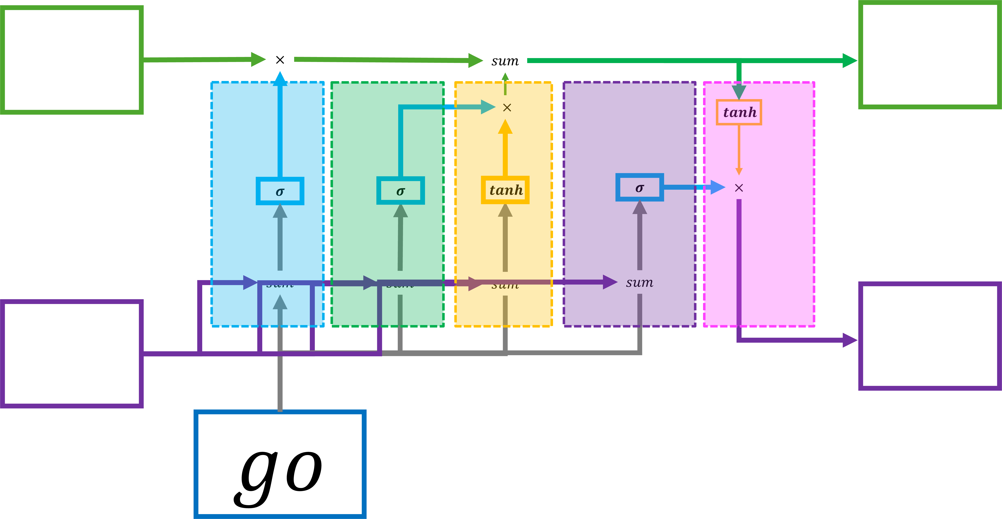
Initial Long
Term Memory
Updated Long
Term Memory
Initial Short
Term Memory
Updated Short
Term Memory
Input Value
Input Value
From our last lecture, we already know how to deal with variable length inputs and outputs using LSTMs

Slide 13
Initial Long
Term Memory
Updated Long
Term Memory
Initial Short
Term Memory
Updated Short
Term Memory
Input Value
Input Value
Also from our previous lecture about word embeddings, we cannot just pass words into a neural network

Slide 14
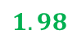
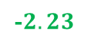
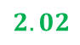
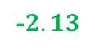
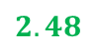
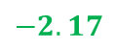
$$2.02$$
$$1.98$$
$$−2.17$$
-$2.23$
1.99
$$2.48$$
-$2.13$
1.73
at
Tara
ba
<EOS>
Instead, we use an embedding layer to convert words to numbers.

Slide 15
$$2.02$$
$$1.98$$
$$−2.17$$
-$2.23$
1.99
$$2.48$$
-$2.13$
1.73
Let
us
go
<EOS>
To keep everything simple, our English vocabulary will only have 3 words and the symbol <EOS> which means end of sentence

Slide 16
$$2.02$$
$$1.98$$
$$−2.17$$
-$2.23$
1.99
$$2.48$$
-$2.13$
1.73
Let
us
go
<EOS>
The words and symbols represent individual elements in our vocabulary and they are referred as Tokens

Slide 17
$$2.02$$
$$1.98$$
$$−2.17$$
-$2.23$
1.99
$$2.48$$
-$2.13$
1.73
Let
us
go
<EOS>
In this example, we will only we using 2 embedding values per token.

Slide 18
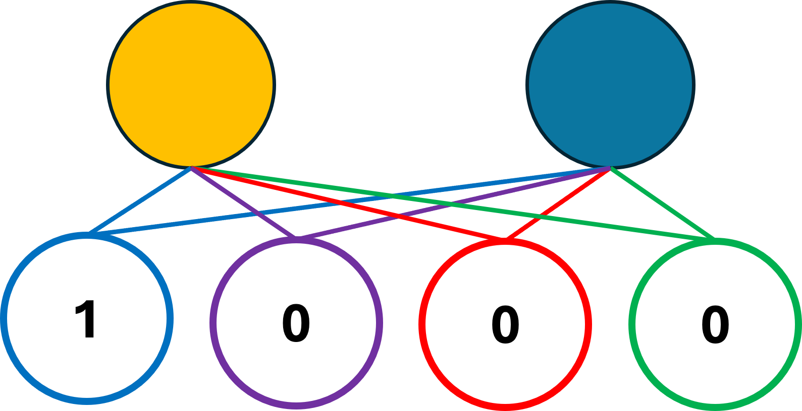
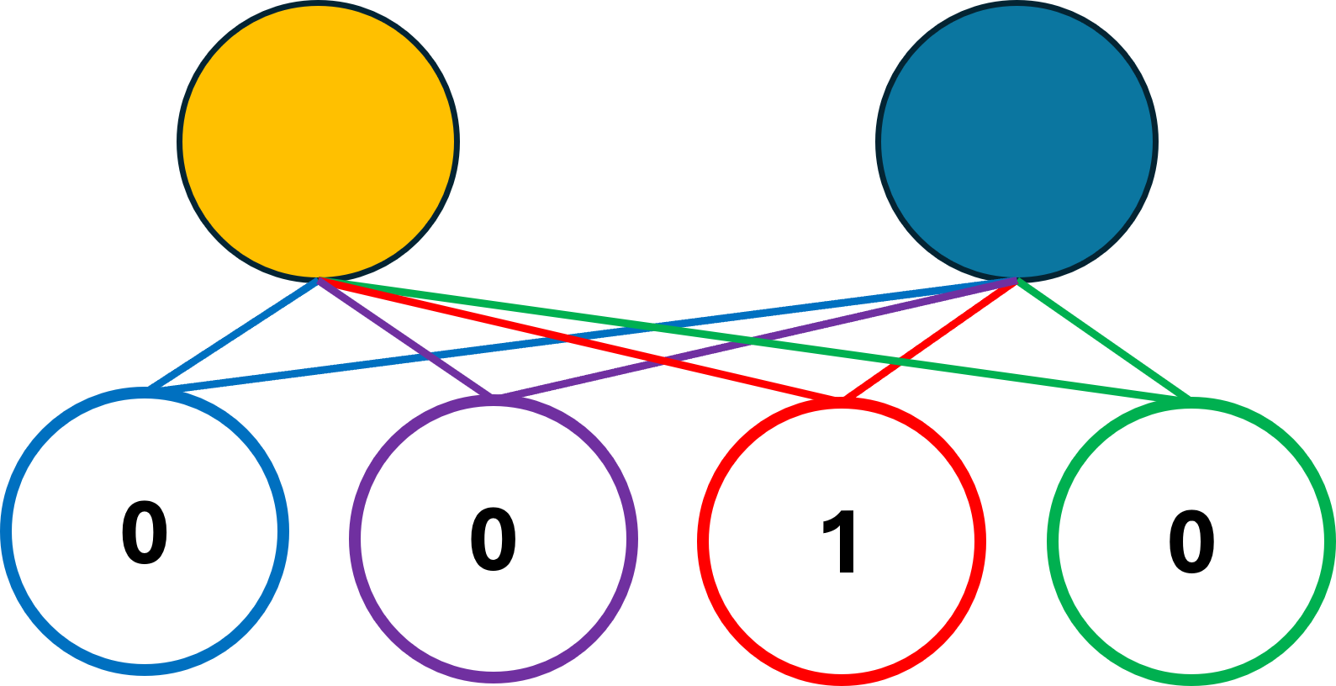
These embedding layers will serve as input for our LSTMs
Lets
us
go
<EOS>
Lets
us
go
<EOS>

Slide 19
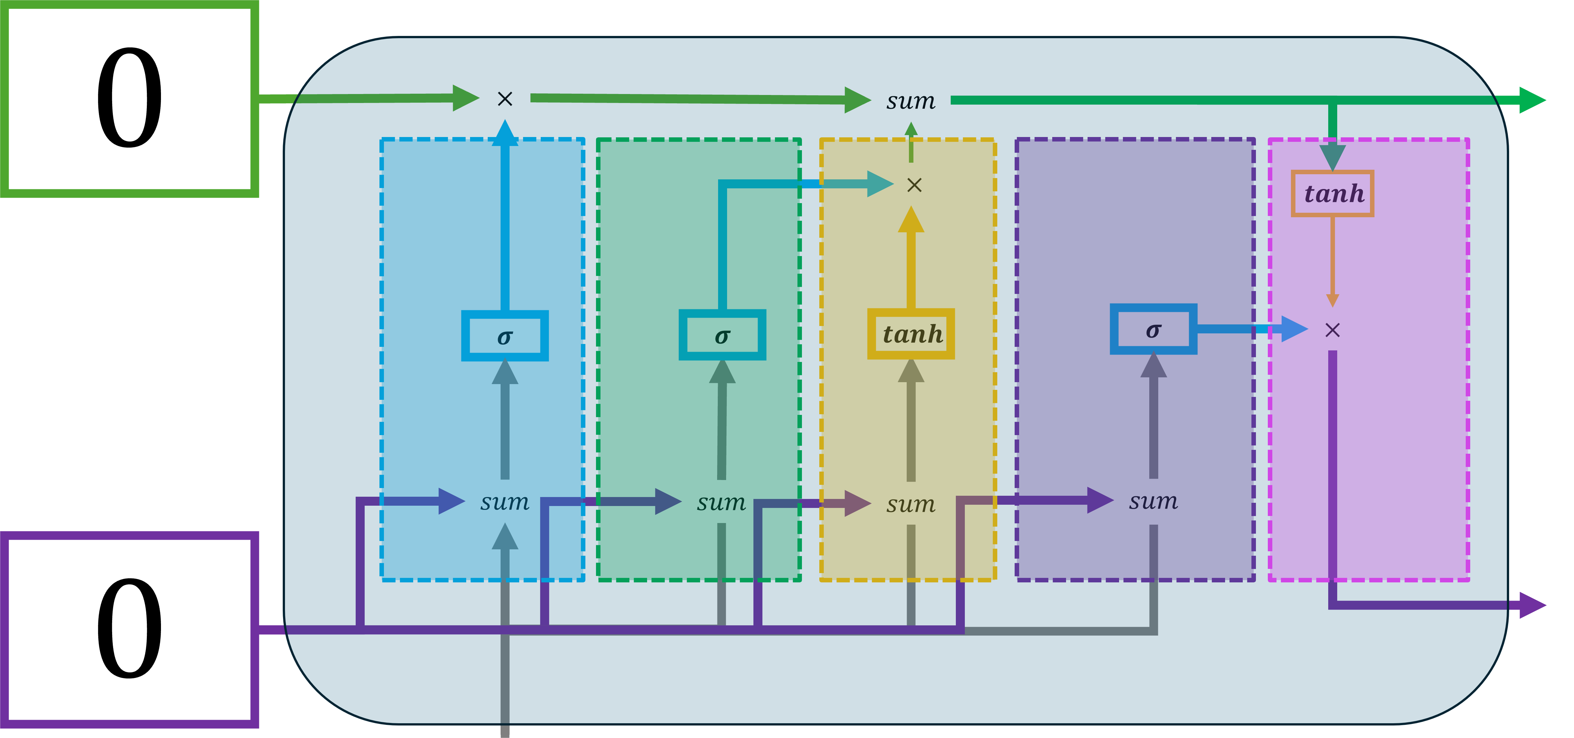
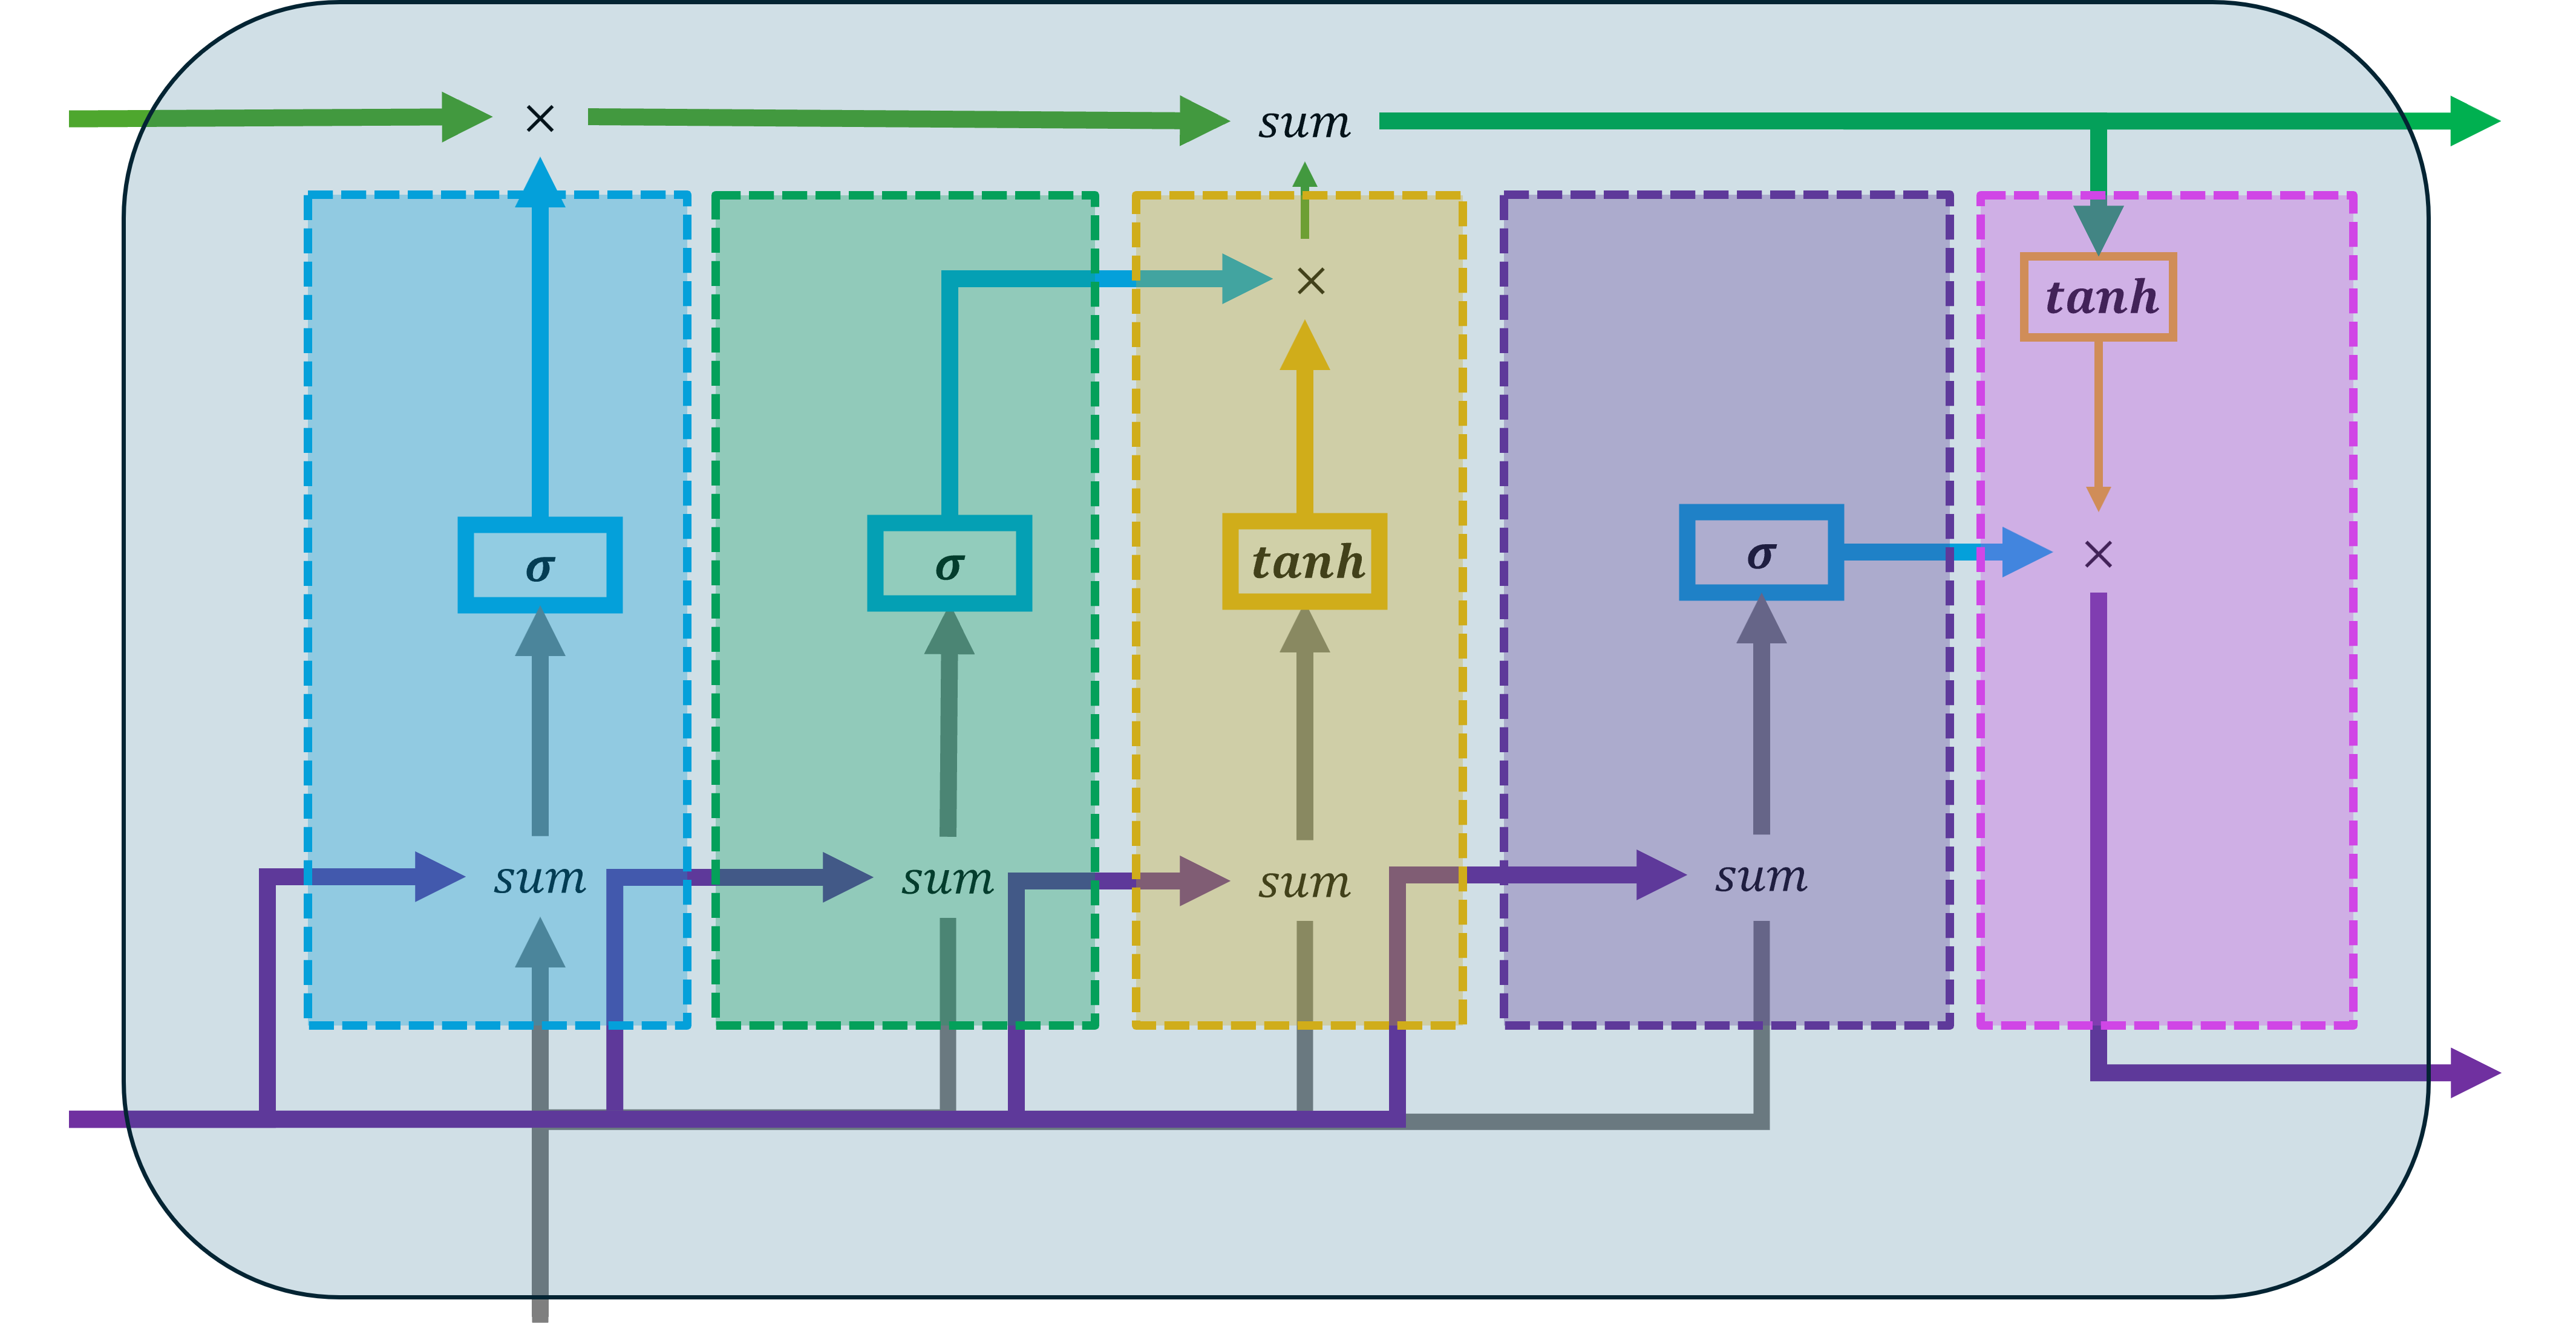
These embedding layers will serve as input for our LSTMs
Lets
us
go
<EOS>
Lets
us
go
<EOS>

Slide 20
These embedding layers will serve as input for our LSTMs
Lets
us
go
<EOS>
Lets
us
go
<EOS>

Slide 21
In practice, in order to have more Weights and Biases to fit the model to our data, people often add additional LSTM cells to the input.
Lets
us
go
<EOS>
Lets
us
go
<EOS>

Slide 22
This means that 2 embedding values for the word “Lets” are used as the input values for two different LSTM cells.
And these 2 LSTM cells have their own separate sets of Weights and Biases
Lets
us
go
<EOS>
Lets
us
go
<EOS>

Slide 23
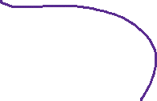
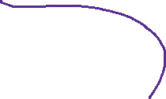
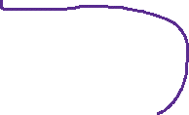
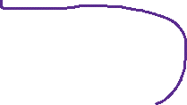
To add even more Weights and Biases to fit the model to our data, people often add additional layers of LSTMS
Lets
us
go
<EOS>
Lets
us
go
<EOS>

Slide 24
What this does is the output values from the unrolled LSTMS units in the first layer are used as inputs to the LSTMs in the second layer.
Lets
us
go
<EOS>
Lets
us
go
<EOS>

Slide 25
Now we are done creating the Encoder part of the Encoder-Decoder model
Encoder
Lets
us
go
<EOS>
Lets
us
go
<EOS>

Slide 26
In essence, the Encoder encodes the input sentence “Lets go” into a collection of long and short term memories
Encoder
Lets
us
go
<EOS>
Lets
us
go
<EOS>

Slide 27

The long and short term memories from both layers of the LSTM cells in the encoder are called the Context Vector
Encoder
$$C$$
$$o$$
$$n$$
$$t$$
$$e$$
$$x$$
$$t$$
$$V$$
$$e$$
$$c$$
$$t$$
$$o$$
$$r$$
Lets
us
go
<EOS>
Lets
us
go
<EOS>

Slide 28
Thus, the Encoder encodes the input sentence “Lets go” into the Context Vector.
Encoder
$$C$$
$$o$$
$$n$$
$$t$$
$$e$$
$$x$$
$$t$$
$$V$$
$$e$$
$$c$$
$$t$$
$$o$$
$$r$$
Lets
us
go
<EOS>
Lets
us
go
<EOS>

Slide 29
Now we need to decode the Context Vector.
Encoder
$$C$$
$$o$$
$$n$$
$$t$$
$$e$$
$$x$$
$$t$$
$$V$$
$$e$$
$$c$$
$$t$$
$$o$$
$$r$$
Lets
us
go
<EOS>
Lets
us
go
<EOS>

Slide 30
So the first thing we do is connect the long and short term memories that form the context vector to a new set of LSTMs
Encoder
Lets
us
go
<EOS>
Lets
us
go
<EOS>

Slide 31
Just like the Encoder, they also have 2 layers and 2 cells but have their own separate Weights and Biases
Encoder
Lets
us
go
<EOS>
Lets
us
go
<EOS>

Slide 32
The goal of the Decoder is to decode the Context Vector into the output sentence
Encoder
Lets
us
go
<EOS>
Lets
us
go
<EOS>

Slide 33

Just like in the Encoder, the input to the LSTM cells comes from an Embedding Layer
Encoder
Lets
us
go
<EOS>
Lets
us
go
<EOS>
at
Tara
ba
<EOS>

Slide 34
But this time, the embedding layer creates embedding values for the Tagalog words “at”, “Tara”, “ba” and the <EOS> symbol
Encoder
Lets
us
go
<EOS>
Lets
us
go
<EOS>
at
Tara
ba
<EOS>

Slide 35
The Decoder starts with the embedding values for the <EOS> token. We are doing this because this is what they used in the original paper
Encoder
Lets
us
go
<EOS>
Lets
us
go
<EOS>
at
Tara
ba
<EOS>

Slide 36
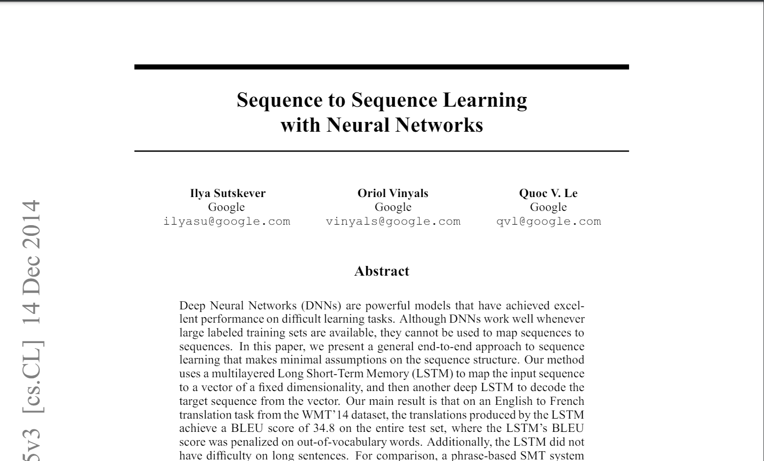
Original Seq2Seq paper
One of the first attempts to solve sequence-to-sequence tasks using neural networks by Sutskever et.al
https://arxiv.org/pdf/1409.3215

Slide 37
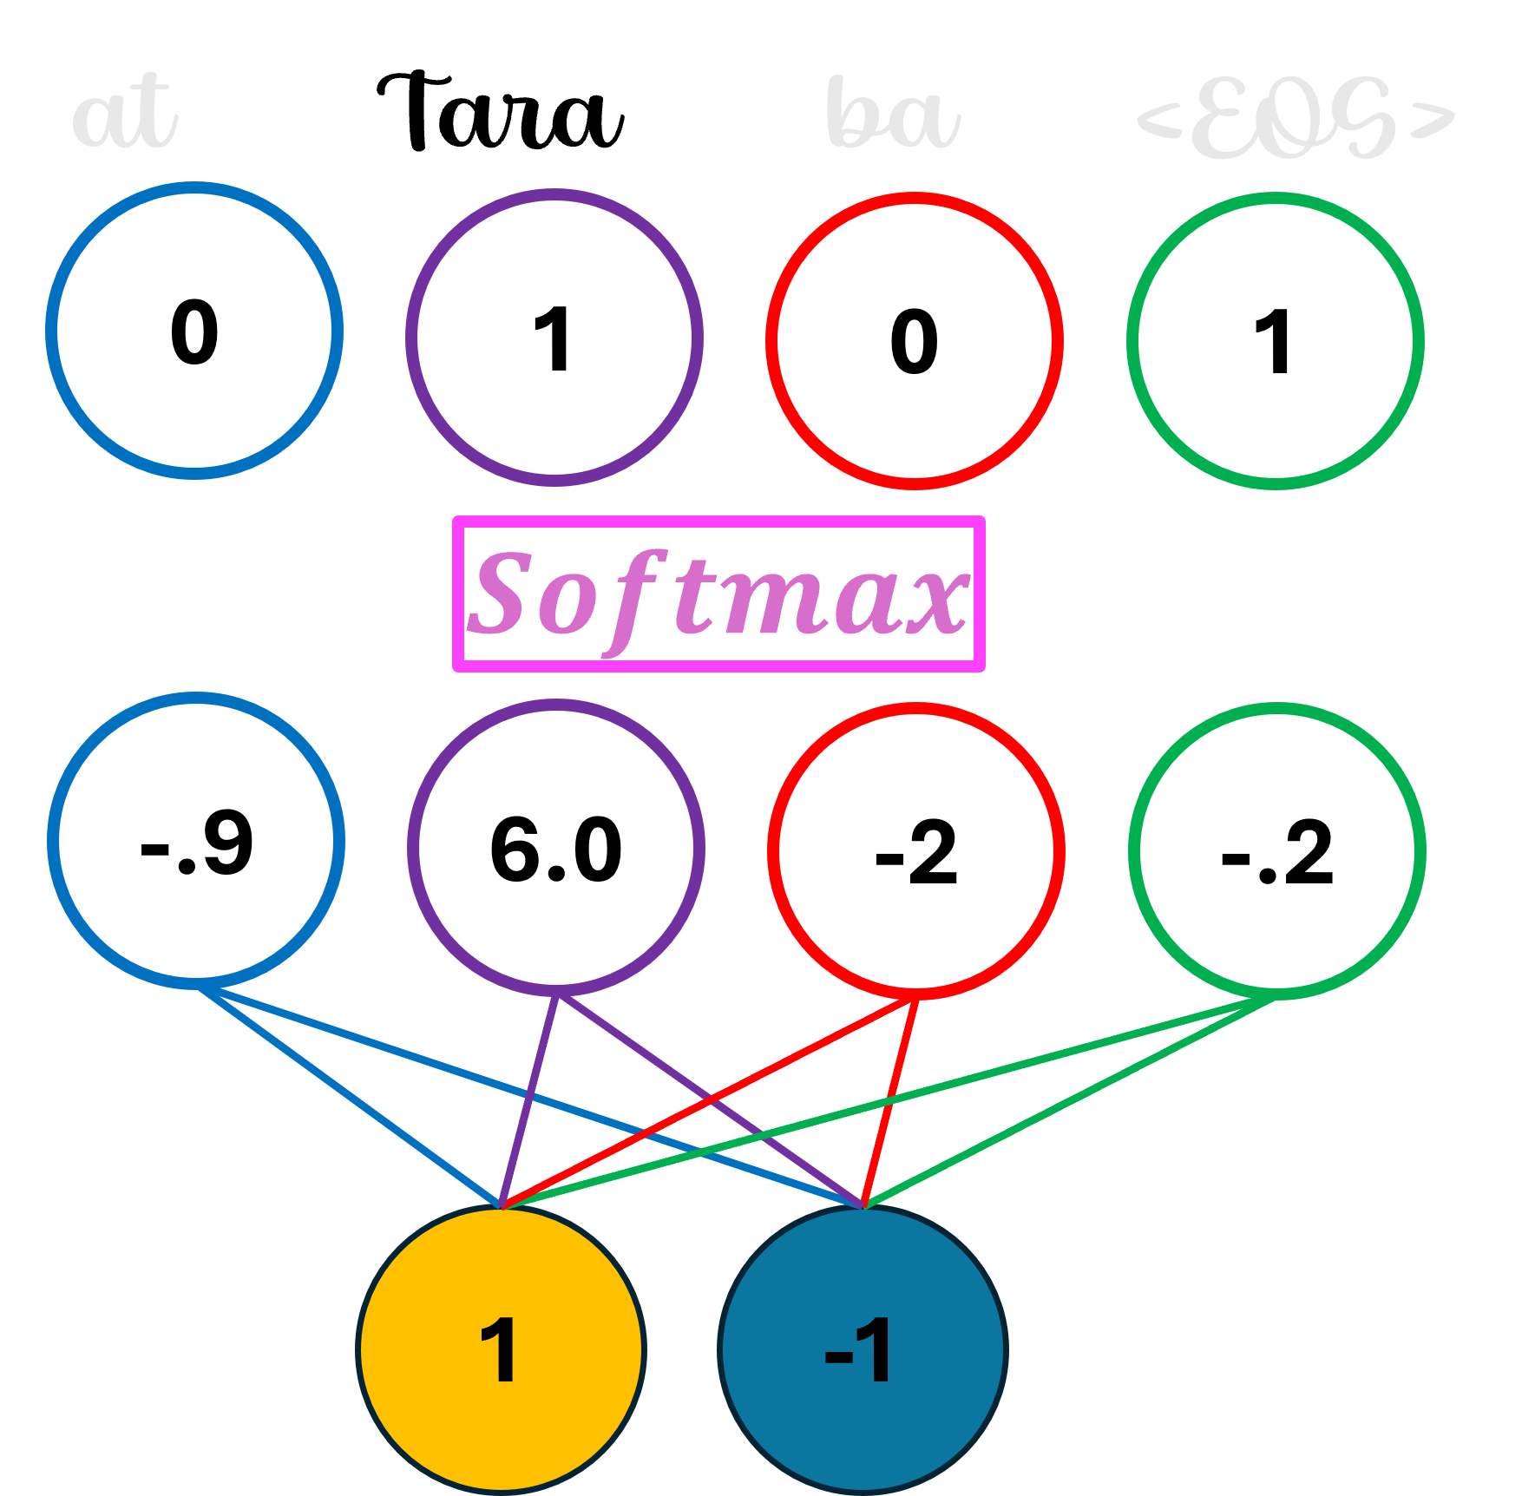
The output values from the top layer of the LSTM in the Decoder are transformed by additional Weights and Biases in a Fully Connected Layer
Encoder
Lets
us
go
<EOS>
Lets
us
go
<EOS>
at
Tara
ba
<EOS>

Slide 38
This Fully Connected Layer has 2 inputs that come from the LSTM cells in the top layer and 4 outputs for each token in the Tagalog vocabulary
Encoder
Lets
us
go
<EOS>
Lets
us
go
<EOS>
at
Tara
ba
<EOS>

Slide 39
If we run it to the Fully Connected Layer, we see that the output is “Tara”, the tagalog translation for “Lets go”
Encoder
Lets
us
go
<EOS>
Lets
us
go
<EOS>
at
Tara
ba
<EOS>

Slide 40
The translation is correct but the Decoder does not stop until it outputs an <EOS> token
Encoder
Lets
us
go
<EOS>
Lets
us
go
<EOS>
at
Tara
ba
<EOS>

Slide 41

So we plug the word “Tara” into the unrolled Embedding Layer
Encoder
Lets
us
go
<EOS>
Lets
us
go
<EOS>
at
Tara
ba
<EOS>
at
Tara
ba
<EOS>

Slide 42
And then unroll 2 LSTM cells in each layer
Encoder
Lets
us
go
<EOS>
Lets
us
go
<EOS>
at
Tara
ba
<EOS>
at
Tara
ba
<EOS>

Slide 43



And run the output values into the same Fully Connected Layer.
And the next predicted token is <EOS>
Encoder
Lets
us
go
<EOS>
Lets
us
go
<EOS>
at
Tara
ba
<EOS>
at
Tara
ba
<EOS>

Slide 44
In practice, the Decoder will keep predicting words until it predicts <EOS> or it hits a max limit.
Decoder
Encoder
Lets
us
go
<EOS>
Lets
us
go
<EOS>
at
Tara
ba
<EOS>
at
Tara
ba
<EOS>

Slide 45
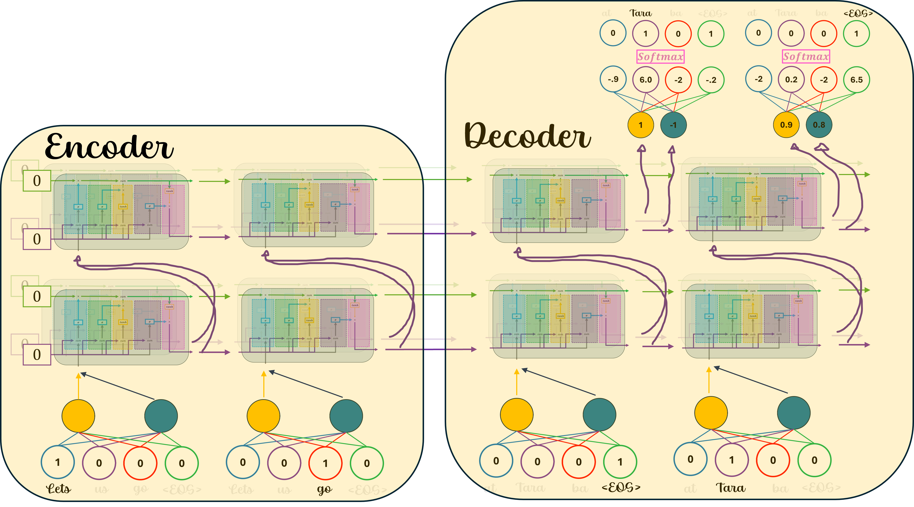
In the original paper by Sutskever et.al, the original model had an input vocabulary of 160,000 tokens

Slide 46
And an output vocabulary with 80,000 tokens

Slide 47
Instead of 2 embedding values per token, the original created 1000

Slide 48
And instead of 2 layers and 2 LSTM cells in each layer, the original had 4 layers with 1000 LSTM cells per layer

Slide 49
The Output Layer had 1000 inputs from the 1000 LSTM cells in the 4th layer

Slide 50
And 80,000 outputs to match the size of the output vocabulary

Slide 51
Lastly, the original model had 384,000,000 Weights and Biases to train.

Slide 52
References
https://arxiv.org/pdf/1409.3215
https://lena-voita.github.io/nlp_course/seq2seq_and_attention.html

Slide 53
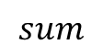
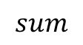

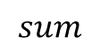

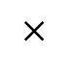
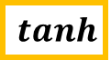
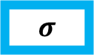
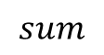
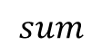
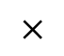

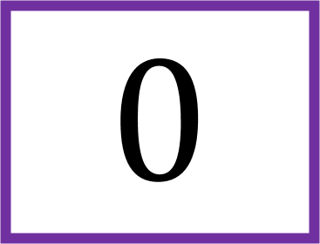
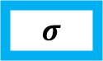

$$0$$
$$×$$
$$sum$$
$$×$$
$$tanh$$
$$σ$$
$$σ$$
$$tanh$$
$$σ$$
$$×$$
$$sum$$
$$sum$$
$$sum$$
$$sum$$
$$0$$

Slide 54
$$×$$
$$sum$$
$$×$$
$$tanh$$
$$σ$$
$$σ$$
$$tanh$$
$$σ$$
$$×$$
$$sum$$
$$sum$$
$$sum$$
$$sum$$

Slide 55

$$0$$
$$×$$
$$sum$$
$$×$$
$$tanh$$
$$σ$$
$$σ$$
$$tanh$$
$$σ$$
$$×$$
$$sum$$
$$sum$$
$$sum$$
$$sum$$
$$0$$
$$Lets$$

Slide 56
0
1
0
0

Slide 57
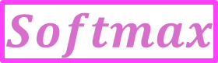
at
Tara
ba
<EOS>
0
1
0
1
$$Softmax$$
-.9
6.0
-2
-.2
1
-1

Slide 58
at
Tara
ba
<EOS>
0
0
0
1
$$Softmax$$
-2
0.2
-2
6.5
0.9
0.8

